Slide 1
Java Web Development basis——
From Servlet To JSP chapter6 ServletBasics of Database Access

Slide 2
learning target:
After studying in this chapter, you should:
To understanding JDBC API
The Steps through JDBC to access the database
Master the use NetBeans Management database
Master the method of "reading" and "writing" the database

Slide 3
review
Technologies currently mastered:
By HTMLSubmit data to the server on the client
byServlet which provided HttpRequest Object, obtain and process the submitted data on the server
By HttpResponse The object responds to the customer
byHttpSessionObject tracking customer sessions
This chapter mainly introduces how Servlet using JDBC to Access a relational database.

Slide 4
6.1 JDBCOverview of connecting to a database
6.1.1 JDBCIntroduction
Java Database Connectivity,(Java Database Connectivity, Referred toJDBC)
By JDBC API, You can access different relational database products in a unified form.
JDBC APIA series of interfaces. The implementation of the interface is provided by the respective database vendors. Database-specific access API is Called database JDBC driver.

Slide 5
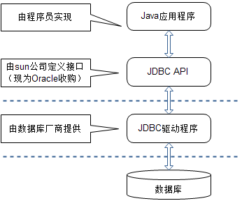
JDBC driver has 4 Category, the highest efficiency is the "pure local protocol Java driver"
Through the "pure local Java Driver" to connect to database

Slide 6
6.1.2 JDBC Steps to access the database
Consider the following questions:
To manipulate the data in the database, you must first connect to the database, so what information do you need to know to connect to the database?
First of all, you have to know what database it is in order to load the database driver of the corresponding manufacturer;
Second, you have to know where the database server is, which database on the database server you want to access, and what is the user name and password for accessing the database;
Finally, write SQL to manipulate the data in the databaseSQLSentence

Slide 7
use JDBCA database operation on the database generally requires the following6Steps
1.Loading JDBC driver
2.Establish a connection via the drive manager
3.Create statement object through connection object
4.Perform database operations through statement objects
5.process result
6.Turn off the objects used in the middle (such as: result set object, statement object, connection object)

Slide 8
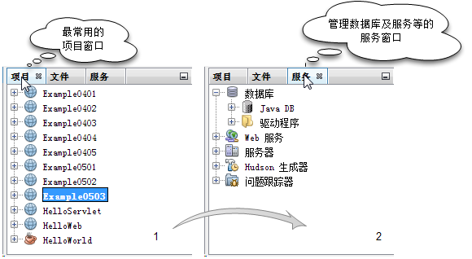
6.2 How to manage the database in NetBeans
Select service window

Slide 9
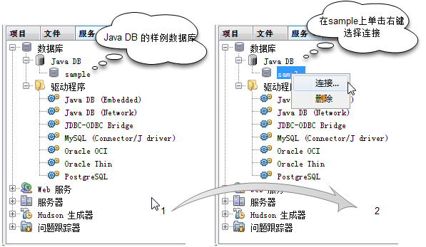
Select sample database

Slide 10
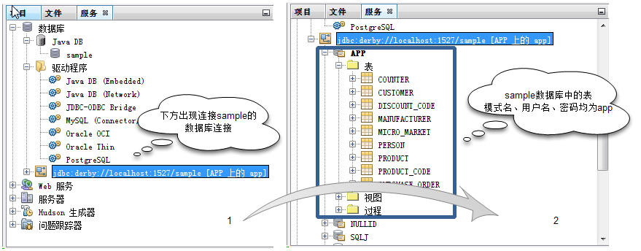
Open the database connection to observe the sample table

Slide 11
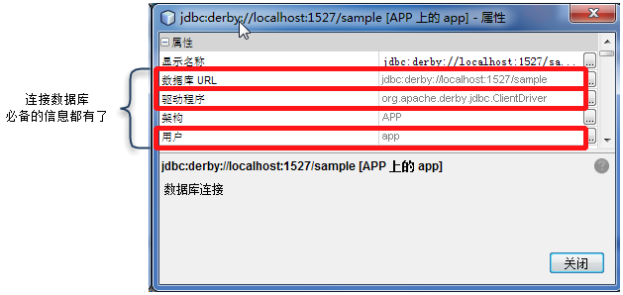
Observe the information contained in the properties of the connection
String url="jdbc:derby://localhost:1527/sample";
String driver="org.apache.derby.jdbc.ClientDriver";
String user="app";
String password="app";

Slide 12
6.3 Perform a "read" operation in the database
1.LoadingJDBCdriver
Class.forName(driver);
2.Establish a connection via the drive manager
Connection conn=DriverManager. getConnection
( Database ConnectivityURL, username, password);
3.Create statement object through connection object
Statement st=conn.createStatement();

Slide 13
4.Perform database operations through statement objects
in the case of"read"operating
Execute statement objectexecuteQuery(String sql)Method, the return type isResultSet.
ResultSet rs=st.executeQuery(String sql);
in the case of"write"operating
Execute statement objectexecuteUpdate(String sql)Method, the return type isint, Which indicates the number of rows affected.
int i=st.executeUpdate(String sql);

Slide 14
5.process result
Depending on the business logic
try{
}catch(Exception e){
}Written in block

Slide 15
6.Turn off the objects used in the middle
(such as: result set object, statement object, connection object)
in the case of"read"operating
rs.close();
st.close();
conn.close();
in the case of"write"operating
st.close();
conn.close();
For the convenience of reading, the above code for closing resources has omitted the part of judging whether the object is empty when closing each object, and the part of exception handling.

Slide 16
6.3.1 Simple query operation in the database(useStatement)
Goal: learn in Servlet by JDBC Perform simple query operations on the database.
Construction name:Example0601
Files used:
file name | Description
SimpleQueryServlet | Manually createdServlet, Used to obtain the information submitted by the user through the hyperlink, and display it in the form of a web page.

Slide 17
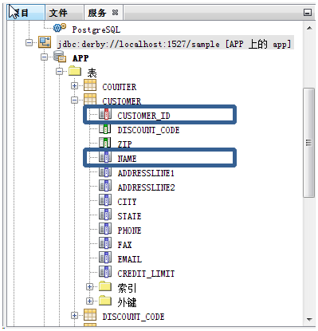
Known conditions: the content to be queried is as follows
database: | Sample databasesample
Table Name: | customer | (The table structure is shown in the figure)
Field name to be queried: | customer_id | The data type isINTEGER
 | name | The data type isVARCHAR

Slide 18
Programming ideas:
1. declare and initialize the objects that need to be used
2. Declare and initialize the parameter information required to connect to the database
3. follow the steps to operate the database

Slide 19
1, declare and initialize the objects that need to be used
Connection conn=null;
Statement st=null;
ResultSet rs=null;
2. Declare and initialize the parameter information required to
connect to the database
String url="jdbc:derby://localhost:1527/sample";
String driver="org.apache.derby.jdbc.ClientDriver";
String user="app";
String password="app";

Slide 20
3SimpleQueryServletcode show as below
SimpleQueryServlet.java(part1)
protected void processRequest(HttpServletRequest request, HttpServletResponse response)
throws ServletException, IOException {
  response.setContentType("text/html;charset=UTF-8");
  PrintWriter out = response.getWriter();
  Connection conn = null;
  Statement st = null;
  ResultSet rs = null;
  String url = "jdbc:derby://localhost:1527/sample";
  String driver = "org.apache.derby.jdbc.ClientDriver";
  String user = "app";
  String password = "app";
  try {
    //Connect to the database
    //Implement specific business logic
  } finally {
    out.close();
  }
}

Slide 21
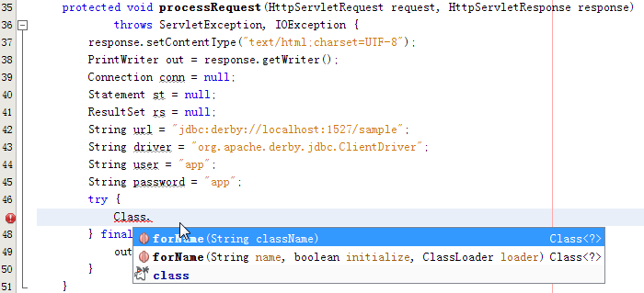
Three, follow the steps to operate the database
1.LoadingJDBCdriver
Class.forName(driver );

Slide 22
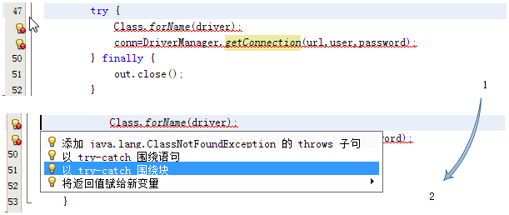
2.Establish a connection via the drive manager
conn=DriverManager.getConnection(url,user,password)
Handling thrown exceptions

Slide 23
SimpleQueryServlet.java(part2)
protected void processRequest(HttpServletRequest request, HttpServletResponse response)
throws ServletException, IOException {
  response.setContentType("text/html;charset=UTF-8");
  PrintWriter out = response.getWriter();
  Connection conn = null; Statement st = null; ResultSet rs = null;
  String url = "jdbc:derby://localhost:1527/sample";
  String driver = "org.apache.derby.jdbc.ClientDriver";
  String user = "app"; String password = "app";
  try {
    Class.forName(driver);
    conn=DriverManager.getConnection(url,user,password);
  } catch (SQLException ex) {
    Logger.getLogger(SimpleQueryServlet.class.getName()).log(Level.SEVERE, null, ex);
  } catch (ClassNotFoundException ex) {
    Logger.getLogger(SimpleQueryServlet.class.getName()).log(Level.SEVERE, null, ex);
  } finally {
  out.close();
  }
}

Slide 24
3.Create statement object through connection object
st=conn.createStatement();
4.Perform database operations through statement objects
String sql="select customer_id, name from customer";
rs=st.executeQuery(sql);
5.process result
ResultSet Object encapsulates the result set of database operations
ps:on ResultSet On the next page

Slide 25
ResultSetThe object maintains a cursor pointing to the current data row, the initial position of the cursor is before the first row, you can pass ResultSet Object of next method moves down.
Method name | Return value type | Applicable situation
next() | boolean | Move the cursor to the next line, if the line exists, returntrue, Otherwise returnfalse.
ResultSet Provides a variety of getXxxMethods, E.g:
customer_id data type is INTEGER, You can call rs.getInt("customer_id") or rs.getInt(1) to get its corresponding value.
If it is just to display the knot, you can also call rs.getString("customer_id")orrs.getString(1)To get its corresponding value.

Slide 26
Note: The column index is about the temporary SQL
String sql="select customer_id, name from customer";
customer_id column index value is 1,
name column index value is 2
If you change sql statement is as follows:
String sql="select name, customer_id from customer";
name column index valueis 1,
customer_id column index value is 2.

Slide 27
Since we don’t know how many rows of data there are, we use while Loop
while(rs.next()){
  out.print(rs.getInt("customer_id"));
  out.print(rs.getString("name"));
}
Consider using a table to format the output, the code after adjustment is as follows
out.print("<table border=1>");
while(rs.next()){
  out.print("<tr>");
  out.print("<td>"+rs.getInt("customer_id")+"</td>");
  out.print("<td>"+rs.getString("name")+"</td>");
  out.print("</tr>");
}
out.print("</table>");

Slide 28
6.Turn off the objects used in the middle
(such as: result set object, statement object, connection object)
Close the result set object
if (rs != null) {
  try {
    rs.close();
  } catch (SQLException ex) {
    Logger.getLogger(SimpleQueryServlet.class.getName()).log(Level.SEVERE, null, ex);
  }
}
Close statement object, connection object is similar to this, the code is omitted here

Slide 29
SimpleQueryServlet.java(all)
protected void processRequest(HttpServletRequest request, HttpServletResponse response)throws ServletException, IOException {
  response.setContentType("text/html;charset=UTF-8");
  PrintWriter out = response.getWriter();
  Connection conn = null;
  Statement st = null;
  ResultSet rs = null;
  String url = "jdbc:derby://localhost:1527/sample";
  String driver = "org.apache.derby.jdbc.ClientDriver";
  String user = "app";
  String password = "app";
  try {
    Class.forName(driver);
    conn = DriverManager.getConnection(url, user, password);
    st = conn.createStatement();
    String sql = "select customer_id, name from customer";
    rs = st.executeQuery(sql);
    out.print("<table border=1>");
    while (rs.next()) {
    out.print("<tr>");
    out.print("<td>" + rs.getInt("customer_id") + "</td>");
    out.print("<td>" + rs.getString("name") + "</td>");
    out.print("</tr>");
    }
    out.print("</table>");
  } catch (SQLException ex) {Logger.getLogger(SimpleQueryServlet.class.getName()).log(Level.SEVERE, null, ex);
  } catch (ClassNotFoundException ex) {Logger.getLogger(SimpleQueryServlet.class.getName()).log(Level.SEVERE, null, ex);
  } finally {
    if (rs != null) {
      try {
        rs.close();
      } catch (SQLException ex) {Logger.getLogger(SimpleQueryServlet.class.getName()).log(Level.SEVERE, null, ex);}
    }
    if (st != null) {
      try {
        st.close();
      } catch (SQLException ex) {Logger.getLogger(SimpleQueryServlet.class.getName()).log(Level.SEVERE, null, ex);}
    }
    if (conn != null) {
      try {
        conn.close();
      } catch (SQLException ex) {Logger.getLogger(SimpleQueryServlet.class.getName()).log(Level.SEVERE, null, ex);}
    }
    out.close();
    }
  }

Slide 30
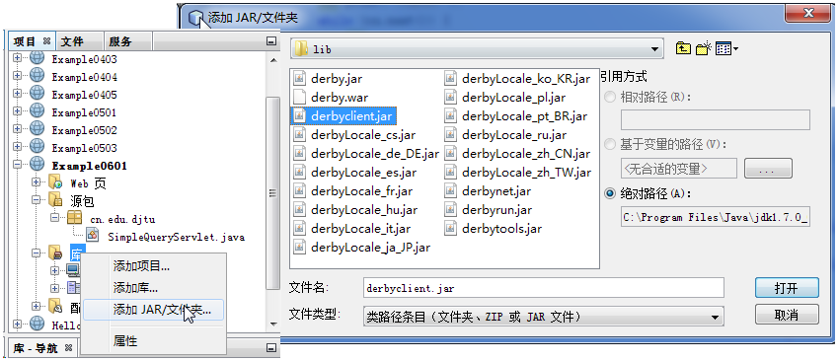
Add driver class

Slide 31
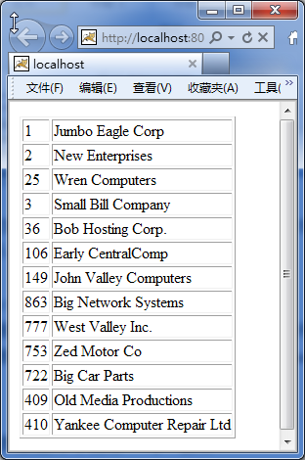
runSimpleQueryServlet
SimpleQueryServletrunning result

Slide 32
6.3.2 Conditional query operations in the database(Splicing query conditions)
Goal: learn in Servlet by JDBC Conditional query operations on the database (using splicing SQLStatement).
Construction name:Example0602
known conditions:
database: | Sample databasesample
Table Name: | customer(The table structure is shown in the figure6.4Shown)
Field name to be queried: | customer_id The data type is INTEGER name The data type is VARCHAR
Query condition field name | discount_code The data type is CHAR

Slide 33
Files used:
file name | Description
index.jsp | Simply rewrite the files that are automatically created when the project is created. Used to submit customersdiscount_codeThe information page contains a form with a text field and a submit button.
DynamicQueryServlet1 | Manually createdServlet, Used to obtain the information submitted by the user through the form (the reason why is called DynamicQueryServlet1 This is because in the next section, the same operation will be implemented in another way, marked with a serial number for distinction).

Slide 34
Programming ideas:
index.jsp Page submit information to DynamicQueryServlet1
DynamicQueryServlet1 Connect to the database and query whether users who meet the conditions exist
If the user exists, format the output of the user customer_id with name
If the user does not exist, no information is displayed.

Slide 35
index.jsp
<body>
  <form action="DynamicQueryServlet1" method="POST">
  discount_code:<input type="text" name="code" value="" />
  <input type="submit" value="submit"/>
  </form>
</body>

Slide 36
DynamicQueryServlet1(part1)
DynamicQueryServlet1First of all, we must obtain the information submitted by the user (of course we must also consider the garbled problem), so this part of the sentence is added, as shown in the red part of the code below.
request.setCharacterEncoding("UTF-8");
response.setContentType("text/html;charset=UTF-8");
PrintWriter out = response.getWriter();
String code = request.getParameter("code");
In addition, you need to adjustSQLStatement, original SQLThe statement is as follows:
String sql = "select customer_id, name from customer";
The adjustments are as follows:
String sql = "select customer_id, name from customer
  where discount_code = '"+code+"' " ;

Slide 37
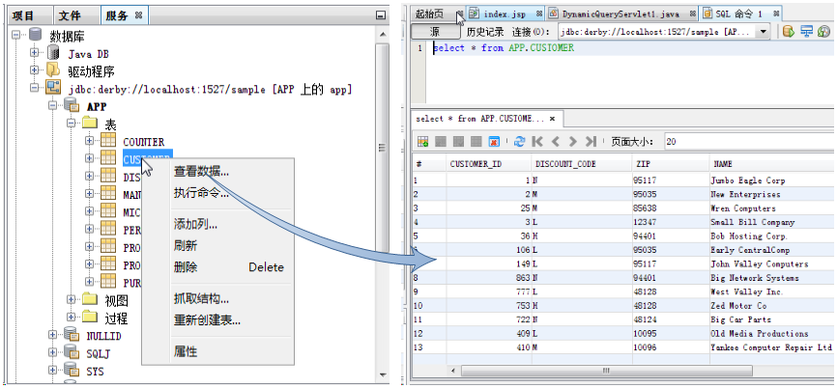
Check it outdiscount_code What values ​​can be taken.
can be seendiscount_codeCan take the value "N", "M", "L", "H"

Slide 38
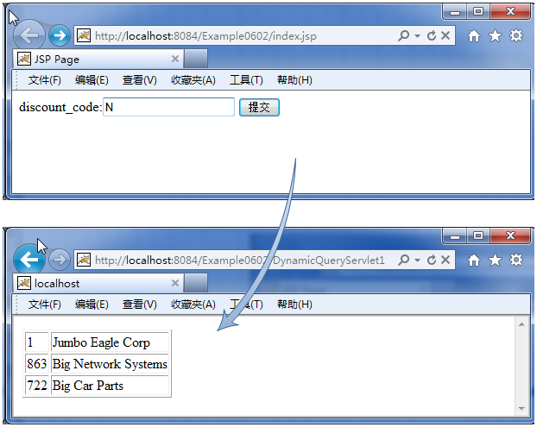
runindex.jsp,enterdiscount_code,E.g:N.

Slide 39
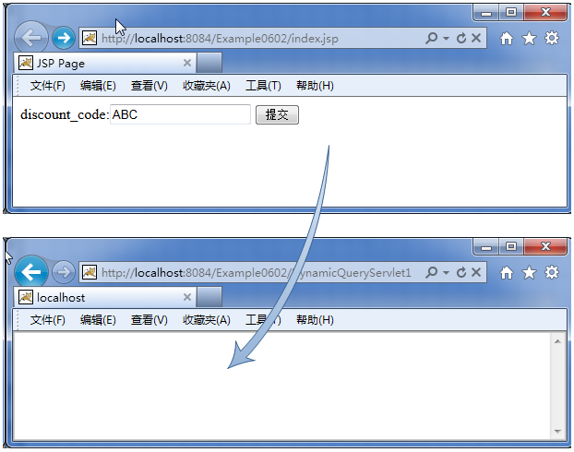
Input non-existentdiscount_codeThe output result when

Slide 40
Splicing SQL Disadvantages of the statement:
When a lot of information is submitted, for example in applications such as user registration, it will lead to SQLstring too long, if it needs to be spliced CHAR or VARCHAR If there are too many, you have to be careful not to omit the single quotes around the variable "'".
Are there other options?
Use PreparedStatement object

Slide 41
6.3.3 Conditional query operations in the database(usePreparedStatement)
PreparedStatement
Execute the same SQLStatement multiple times

Slide 42
usePreparedStatementObjects do not need to consider the issue of splicing, you can use the followingSQLStatement to replace theSQLStatement
String sql = "select customer_id, name from customer where discount_code = '"+code+"' ";
String sql = "select customer_id, name from customer where discount_code= ?";
? The dynamic value represented by PreparedStatementObject of setXxxMethod to set, see the table on the next page for details

Slide 43
PreparedStatementObject commonly usedsetXxxmethod
Method name | Return value type | Applicable situation
setBoolean(int parameterIndex, boolean x) | void | useJavainbooleanType value sets the value of the specified parameter
setDouble(int parameterIndex, double x) | void | useJavaindouble Type value sets the value of the specified parameter
setInt(int parameterIndex, int x) | void | useJavainint Type value sets the value of the specified parameter
setLong(int parameterIndex, long x) | void | useJavainlong Type value sets the value of the specified parameter
setString(int parameterIndex, String x) | void | useJavainString Type value sets the value of the specified parameter

Slide 44
becauseSQLThe statement has been precompiled, so the method called to perform read and write operations should also be adjusted. Read call executeQuery()Method, write call executeUpdate(), Are methods without parameters.
Method name | Return value type | Applicable situation
executeQuery() | ResultSet | Perform query operations and return result set objects
executeUpdate() | int | carried out(DML)Statement, such asINSERT,UPDATE,DELETE, Returns the number of affected result rows;Or executeDDLStatement, returns nothing.

Slide 45
Goal: learn inServletbyJDBCPerform conditional query operations on the database (usingPreparedStatementThe way).
Construction name:Example0602
known conditions:
database: | Sample databasesample
Table Name: | customer(The table structure is shown in the figure6.4Shown)
Field name to be queried: | customer_id The data type isINTEGER name The data type isVARCHAR
Query condition field name | discount_code The data type isCHAR

Slide 46
Files used:
file name | Description
codeinfo.jsp | versusindex.jspThe code is basically the same. There is a form with a text field and a submit button to submit the user’sdiscount_code. Only this time, the form is submitted to DynamicQueryServlet2deal with.
DynamicQueryServlet2 | Manually createdServlet, Used to obtain the information submitted by the user through the form

Slide 47
Programming ideas:
codeinfo.jsp Page submit information to DynamicQueryServlet2
DynamicQueryServlet2 Connect to the database and query whether users who meet the conditions exist
If the user exists, format the output of the user customer_id with name
If the user does not exist, no information is displayed.

Slide 48
codeinfo.jsp
<body>
  <form action="DynamicQueryServlet2" method="POST">
  discount_code:<input type="text" name="code" value="" />
  <input type="submit" value="submit"/>
  </form>
</body>

Slide 49
DynamicQueryServlet2(Part of the code)
request.setCharacterEncoding("UTF-8");
response.setContentType("text/html;charset=UTF-8");
  PrintWriter out = response.getWriter();
  String code = request.getParameter("code");
  Connection conn = null;
  PreparedStatement prst = null;
  ResultSet rs = null;
  String url = "jdbc:derby://localhost:1527/sample";
  String driver = "org.apache.derby.jdbc.ClientDriver";
  String user = "app";
  String password = "app";
try {
  Class.forName(driver);
  conn = DriverManager.getConnection(url, user, password);
  String sql = "select customer_id, name from customer where discount_code=?";
  prst=conn.prepareStatement(sql);
  prst.setString(1, code);
  rs = prst.executeQuery();
Operation effect is slightly

Slide 50
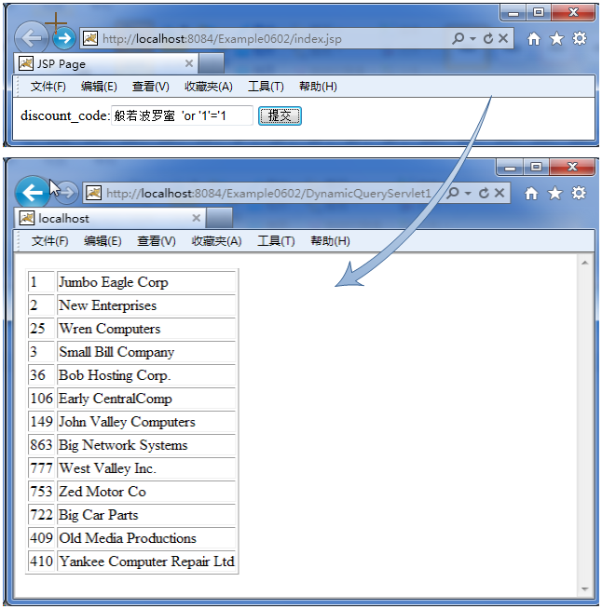
In addition to efficiency considerations, safety considerations PreparedStatement It can also prevent "SQLInject". Inindex.jsp Enter the text in brackets on the page (prajnaparamita 'or '1'='1), obviously this is not a reasonablediscount_code, But you will find that all data will be displayed when you run it
So, inSQLIf dynamic parameters are used in the statement, give priority to usingPreparedStatement.
This is because of using splicing SQL way generates sql ,
select customer_id, name from customer where discount_code='Prajna Paramita'or '1'='1'

Slide 51
6.4 Perform "write" operations in the database
The "write" operation in the database mainly covers three operations "insert", "update" and "delete". The "write" operation in the database involves more problems than the "read operation".
Problem 1:"JavaThe data type in and the data type in the database may not match".
Problem 2: "The data entered by the user is unreasonable"
In the example of the "write" operation, temporarily assume that
all the data entered are reasonable

Slide 52
6.4.1 "accessPERSONDesign of the “table” case
In database sample Add a new table—PERSON
PERSONTable Structure
Field name | type of data | Is it empty
ID | INTEGER | not null
NAME | VARCHAR(50) | not null
PWD | VARCHAR(15) | not null,
GENDER | CHAR(1) | not null

Slide 53
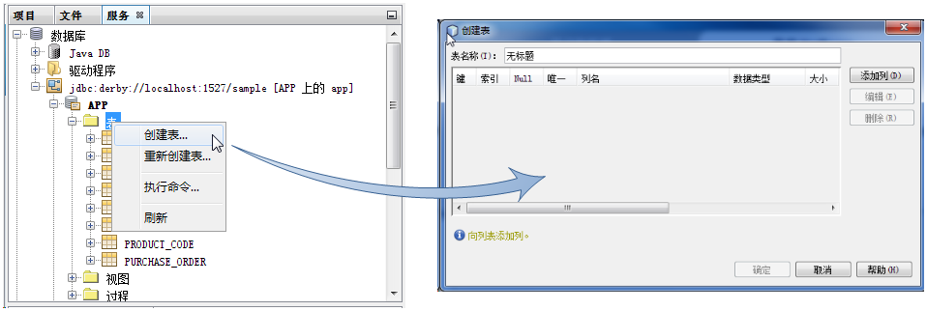
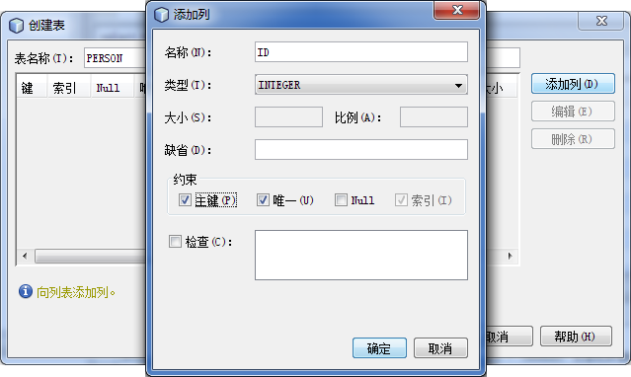
Choose Create Table
Add toIDColumn diagram

Slide 54
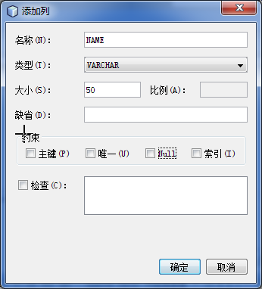
Add toNAMEColumn diagram

Slide 55
Goal: learn inServletbyJDBCPerform a "write" operation on the database.
Construction name:Example0603
Files used:
file name | Description
index.jsp | It is a file automatically created when the project is created. Used as a navigation page, it has the following content: One hyperlink, link toShowAllPersonServlet. The first form, used to submitPERSONAll the information submitted to InsertHandleServle. The second form, submitIDInformation, submit to UpdateHandleServlet. The third form, submitIDInformation, submit to DeleteHandleServlet.
ShowAllPersonServlet | Manually createdServlet,display All PERSON data of the table. In addition, there is a hyperlink toindex.jsp
InsertHandleServle | Manually createdServlet, To obtain all the information submitted by the customer. If the user already exists (ieIDIf the value is repeated), it will prompt "The user already exists!", otherwise the user's information will be inserted into the database.

Slide 56
Continued
file name | Description
UpdateHandleServlet | Manually createdServlet, Get the customer submittedIDInformation such as thisIDExists, output a form, the initial value of each control in the form is thisIDCorresponding value, divided byIDIn addition, other information is allowed to be modified. The form is submitted toUpdatePersonServlet. As thatIDIf it does not exist, it will prompt "No such person is found!".
UpdatePersonServlet | Manually createdServlet, GetUpdateHandleServletThe revised information submitted in the form in the form, the database is updated, and the update is successfully redirected toShowAllPersonServletCheck the updated results.
DeleteHandleServlet | Manually createdServlet, Get the customer submittedIDInformation such as thisIDExists, output a form showing theIDCorresponding information, and ask whether the customer is really ready to delete the data. The form is submitted toDeletePersonServletAs thatIDIf it does not exist, it will prompt "No such person is found!".
DeletePersonServlet | Manually createdServlet, GetDeleteHandleServletForm submissionIDInformation, delete the database, and redirect toShowAllPersonServletCheck the result of the delete operation.

Slide 57
index.jsp
<body>
  <h1>Practice of writing to the database</h1>
  <a href="ShowAllPersonServlet">View existing data in the database</a>
<hr/>
  inPERSONTo add a record to the table, please enter thepersonAll information of
  <form method="POST" action="InsertHandleServlet">
    ID:<input type="text" name="id" value="" /><br/>
    NAME:<input type="text" name="name" value="" /><br/>
    PWD:<input type="password" name="pwd" value="" /><br/>
    GENDER:<input type="radio" name="gender" value="male"checked/>male
    <input type="radio" name="gender" value="Female"/>Female<br/>
    <input type="submit" value="Insert record"/>
  </form>
<hr/>
  inPERSONTo modify a record in the table, please enter thepersonofID
  <form method="POST" action="UpdateHandleServlet">
    ID:<input type="text" name="id" value="" />
    <input type="submit" value="update record"/>
  </form>
<hr/>
  inPERSONTo delete a record from the table, please enter thepersonofID
  <form method="POST" action="DeleteHandleServlet">
    ID:<input type="text" name="id" value="" />
    <input type="submit" value="Delete Record"/>
  </form>
</body>

Slide 58
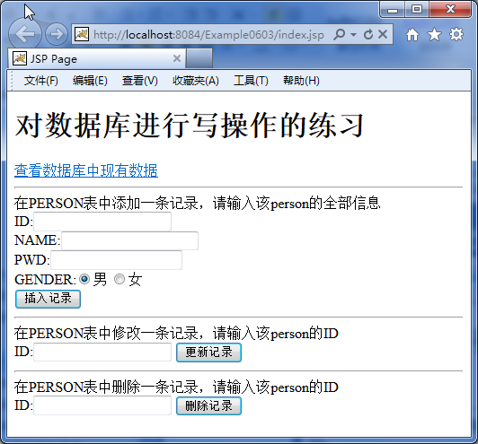
index.jsp running result

Slide 59
6.4.2 PERSON Table query operation
protected void processRequest(HttpServletRequest request, HttpServletResponse response)throws ServletException, IOException {
response.setContentType("text/html;charset=UTF-8");
  PrintWriter out = response.getWriter();
  Connection conn = null;
  PreparedStatement prst = null;
  ResultSet rs = null;
  String url = "jdbc:derby://localhost:1527/sample";
  String driver = "org.apache.derby.jdbc.ClientDriver";
  String user = "app";
  String password = "app";
  try {
    Class.forName(driver);
    conn = DriverManager.getConnection(url, user, password);
    String sql = "select * from person";
    prst=conn.prepareStatement(sql);
    rs = prst.executeQuery();
    out.print("<a href=\"index.jsp\">Back to homepage</a>");
    out.print("<table border=1>");
    while (rs.next()) {
      out.print("<tr>");
      out.print("<td>" + rs.getInt("id") + "</td>");
      out.print("<td>" + rs.getString("name") + "</td>");
      out.print("<td>" + rs.getString("pwd") + "</td>");
      out.print("<td>" + rs.getString("gender") + "</td>");
      out.print("</tr>");
    }
    out.print("</table>");
  } catch (SQLException ex) {Logger.getLogger(ShowAllPersonServlet.class.getName()).log(Level.SEVERE, null, ex);}
  catch (ClassNotFoundException ex) {Logger.getLogger(ShowAllPersonServlet.class.getName()).log(Level.SEVERE, null, ex);}
  finally {slightly}
}

Slide 60
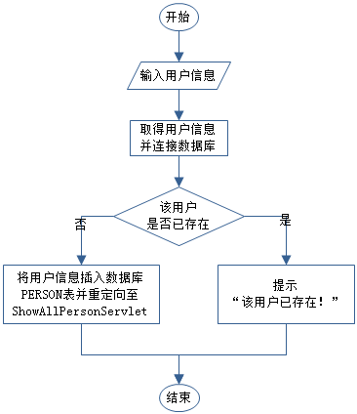
6.4.3 PERSONTable insert operation
Insert Handle Servle Program flow chart

Slide 61
InsertHandleServle.java
protected void processRequest(HttpServletRequest request, HttpServletResponse response)throws ServletException, IOException {
  request.setCharacterEncoding("UTF-8");
  response.setContentType("text/html;charset=UTF-8");
  PrintWriter out = response.getWriter();
  String id=request.getParameter("id");
  String name=request.getParameter("name");
  String pwd=request.getParameter("pwd");
  String gender=request.getParameter("gender");
  Connection conn = null;
  PreparedStatement prst = null;
  ResultSet rs = null;
  String url = "jdbc:derby://localhost:1527/sample";
  String driver = "org.apache.derby.jdbc.ClientDriver";
  String user = "app";
  String password = "app";
  try {
    Class.forName(driver);
    conn = DriverManager.getConnection(url, user, password);
    String sql1 = "select * from person where id=?";
    String sql2 = "insert into person values(?,?,?,?)";
    prst = conn.prepareStatement(sql1);
    prst.setInt(1, Integer.parseInt(id));
    rs = prst.executeQuery();
    if (rs.next()) {
      out.print("The user already exists");
    } else {
      prst = conn.prepareStatement(sql2);
      prst.setInt(1, Integer.parseInt(id));
      prst.setString(2, name);
      prst.setString(3, pwd);
      prst.setString(4, gender);
      prst.executeUpdate();
      response.sendRedirect("ShowAllPersonServlet");
    }
  } catch (SQLException ex) {Logger.getLogger(InsertHandleServlet.class.getName()).log(Level.SEVERE, null, ex);
  } catch (ClassNotFoundException ex) {Logger.getLogger(InsertHandleServlet.class.getName()).log(Level.SEVERE, null, ex);
  } finally {slightly}
}

Slide 62
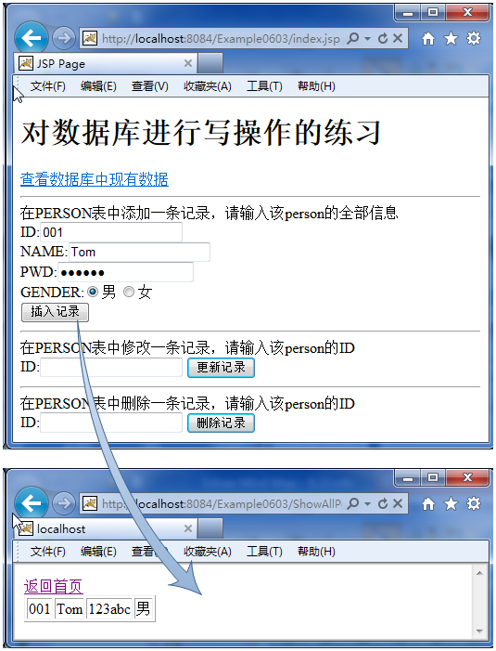
When inserting data in the PERSON table, the running effect is as shown in the figure. After inserting successfully,index.jsp redirect to ShowAllPersonServlet , In order to display the data just inserted, click the hyperlink of "return to home page" to return index.jsp.

Slide 63
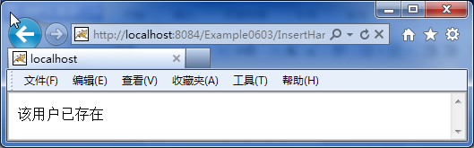
If the inserted data is already existing data (according to ID Judgment, because in the database ID Is the primary key), then the prompt "The user already exists".
toInsert again into the PERSON table “ID - 001”, the running effect is shown in the figure

Slide 64
6.4.4 PERSONTable update operation
The update operation also uses the form, but it is not the same as the insert operation: during the insert operation, the initial value of the control in the form is empty, but during the update operation, the form control should have an initial value, and the initial value should be the same The updated piece of data has a one-to-one correspondence with each field. The process of binding this form control to the field value in the database is called "form data backfilling".
Why do you want to do this?

Slide 65
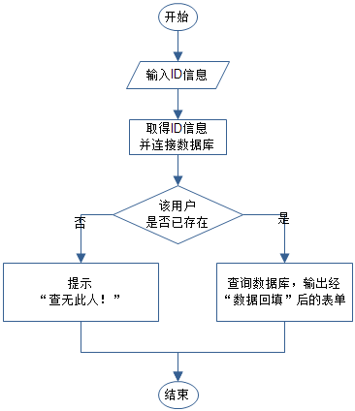
In this case, the update operation is divided into two steps:
first step submitted by the clientID Information, and query the database to determine whether the user exists, if there is, output the "data backfill" form, otherwise it will prompt "check no such person!";
Second step, The customer submits the information again through the "data backfill" form, connects to the database again, and completes the data update work.
first step,UpdateHandleServletProgram flow chart

Slide 66
UpdateHandleServlet.java
try {
  Class.forName(driver);
  conn = DriverManager.getConnection(url, user, password);
  String sql = "select * from person where id=?";
  prst = conn.prepareStatement(sql);
  prst.setInt(1, Integer.parseInt(id));
  rs = prst.executeQuery();
  if (rs.next()) {
    String name = rs.getString("name");
    String pwd = rs.getString("pwd");
    String gender = rs.getString("gender");
    out.print("<html>");
    out.print("<head><title>Update user information</title></head>");
    out.print("<body>");
    out.print("<form action=\"UpdatePersonServlet\" method=\"post\">");
    out.print("ID:" + id + "<input type=\"hidden\" name=\"id\" value=\"" + id + "\"/><br/>");
    out.print("NAME:<input type=\"text\" name=\"name\" value=\"" + name + "\"/><br/>");
    out.print("PWD:<input type=\"password\" name=\"pwd\" value=\"" + pwd + "\"/><br/>");
    if ("male".equals(gender)) {
      out.print("GENDER:<input type=\"radio\" name=\"gender\" value=\"male\" checked />male");
      out.print("<input type=\"radio\" name=\"gender\" value=\"Female\"/>Female<br/>");
    } else {
      out.print("GENDER:<input type=\"radio\" name=\"gender\" value=\"male\"/>male");
      out.print("<input type=\"radio\" name=\"gender\" value=\"Female\" checked />Female<br/>");
    }
    out.print("<input type=\"submit\" value=\"Update\"/>");
    out.print("</form>");
    out.print("</body>");
    out.print("</html>");
  } else {
    out.print("No such person found!");
  }
} catch (SQLException ex) {} catch (ClassNotFoundException ex) {} finally {}

Slide 67
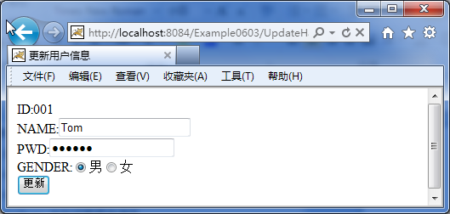
Assuming the input ID for 001, The running effect is shown in the figure

Slide 68
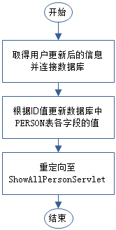
The second step,UpdatePersonServlet Program flow chart
In the second step, customers modify the value of a field according to their needs, and then submit the revised information to UpdatePersonServlet,by UpdatePersonServlet Update the database and redirect to ShowAllPersonServlet Check the updated results. The program flow chart is shown in the figure.

Slide 69
UpdatePersonServlet.java
protected void processRequest(HttpServletRequest request, HttpServletResponse response)throws ServletException, IOException {
  request.setCharacterEncoding("UTF-8");
  response.setContentType("text/html;charset=UTF-8");
  PrintWriter out = response.getWriter();
  String id = request.getParameter("id");
  String name = request.getParameter("name");
  String pwd = request.getParameter("pwd");
  String gender = request.getParameter("gender");
  Connection conn = null;
  PreparedStatement prst = null;
  ResultSet rs = null;
  String url = "jdbc:derby://localhost:1527/sample";
  String driver = "org.apache.derby.jdbc.ClientDriver";
  String user = "app";
  String password = "app";
  try {
    Class.forName(driver);
    conn = DriverManager.getConnection(url, user, password);
    String sql = "update person set name=?,pwd=?,gender=? where id=?";
    prst = conn.prepareStatement(sql);
    prst.setString(1, name);
    prst.setString(2, pwd);
    prst.setString(3, gender);
    prst.setInt(4, Integer.parseInt(id));
    prst.executeUpdate();
    response.sendRedirect("ShowAllPersonServlet");
  } catch (SQLException ex) {} catch (ClassNotFoundException ex) {} finally {}
}

Slide 70
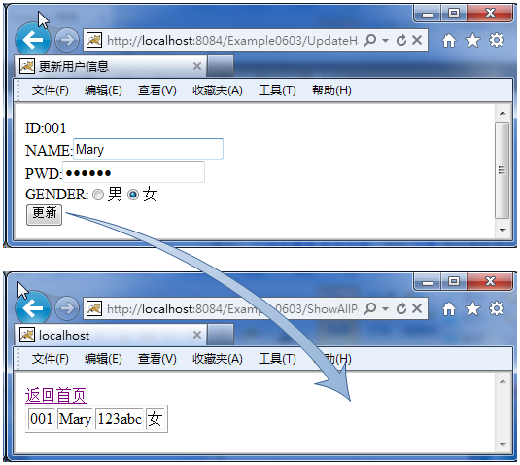
Change part of the information, the operation effect is as shown in the figure
Update operation effect

Slide 71
6.4.5 PERSONTable delete operation
The delete operation is similar to the update operation. The difference is that a form must be provided in the update operation, and all fields of the form are initialized with information in the database.
The delete operation only needs to display relevant information without binding the information to the field. Still need to pass ID Information in the delete operation. In this case, the hidden field is still used to passIDinformation.

Slide 72
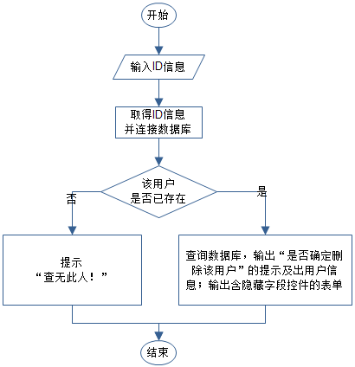
The deletion operation is also divided into two steps:first step, submitted by the clientID Information, and query the database to determine whether the user exists. If there is, remind "Are you sure to delete this user?" and deleted All corresponding information; otherwise, prompts "No such person is found!";Second step, The customer clicks the "OK" button to complete the data deletion.
first step,DeleteHandleServletProgram flow chart

Slide 73
DeleteHandleServlet.java
try {
  Class.forName(driver);
  conn = DriverManager.getConnection(url, user, password);
  String sql = "select * from person where id=?";
  prst = conn.prepareStatement(sql);
  prst.setInt(1, Integer.parseInt(id));
  rs = prst.executeQuery();
  if (rs.next()) {
    String name = rs.getString("name");
    String pwd = rs.getString("pwd");
    String gender = rs.getString("gender");
    out.print("<html>");
    out.print("<head><title>delete users</title></head>");
    out.print("<body>");
    out.print("Are you sure to delete this user?");
    out.print("ID:"+id+"<br/>");
    out.print("NAME:"+name+"<br/>");
    out.print("PWD:"+pwd+"<br/>");
    out.print("GENDER:"+gender+"<br/>");
    out.print("<form action=\"DeletePersonServlet\" method=\"post\">");
    out.print("<input type=\"hidden\" name=\"id\" value=\"" + id + "\"/><br/>");
    out.print("<input type=\"submit\" value=\"determine\"/>");
    out.print("<a href=\"index.jsp\">return</a>");
    out.print("</form>");
    out.print("</body>");
    out.print("</html>");
  } else {
    out.print("No such person found!");
  }
} catch (SQLException ex) {} catch (ClassNotFoundException ex) {} finally {}

Slide 74
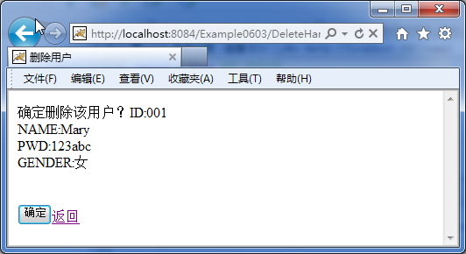
Assuming the inputIDfor001, The running effect is shown in the figure

Slide 75
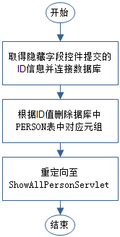
The second step,DeletePersonServletProgram flow chart
The second step, if the customer clicks the "OK" button, thenIDInformation submitted to DeletePersonServlet,by DeletePersonServlet Delete the database and redirect to ShowAllPersonServlet Check the result after deletion. The program flow chart is shown in the figure.

Slide 76
DeletePersonServlet.java
protected void processRequest(HttpServletRequest request, HttpServletResponse response)throws ServletException, IOException {
  rrequest.setCharacterEncoding("UTF-8");
  response.setContentType("text/html;charset=UTF-8");
  PrintWriter out = response.getWriter();
  String id = request.getParameter("id");
  Connection conn = null;
  PreparedStatement prst = null;
  String url = "jdbc:derby://localhost:1527/sample";
  String driver = "org.apache.derby.jdbc.ClientDriver";
  String user = "app";
  String password = "app";
  try {
    Class.forName(driver);
    conn = DriverManager.getConnection(url, user, password);
    String sql = "delete from person where id=?";
    prst = conn.prepareStatement(sql);
    prst.setInt(1, Integer.parseInt(id));
    prst.executeUpdate();
    response.sendRedirect("ShowAllPersonServlet");
  } catch (SQLException ex) {} catch (ClassNotFoundException ex) {} finally {}
}

Slide 77
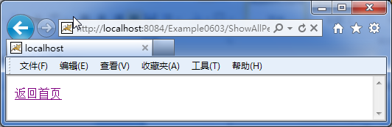
Delete the information, the operation effect is as shown in the figure
Delete operation effect

Slide 78
Homework problems
[1].Glossary:JDBC
[2].Brief introductionJDBCGeneral steps for query operations in the database
[3].Brief introductionJDBCGeneral steps for updating operations in the database
[4].What are the sentence objects introduced in this book? What is the difference and connection between them

